Slide 1
YOUTH EXPANSION PROGRAM
The Future is in our Hands

Slide 2
2021-2022 Campaign
Councils donated $ 96,905.00
Intrest $ 7.00
Masses $ 1,565.00
Misc. $ 4,195.00
TOTAL COLLECTED $ 102,672.00
2021-2022 BUDGET $ 103,700.00
2023-2024 BUDGET $ 95,500.00

Slide 3
CYLA
State Finalist competing for the top CYLA award
16 High Schools Seniors competing for top honors
Girl Winner
Boy Winner
Budget for CYLA awards $ 37,500.00

Slide 4
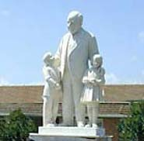
St. Mary’s Training Center
BUDGET $ 6,500

Slide 5
FREE THROW CONTEST
Our children competed at the State Free Throw Finals.
Winning trophies were presented to boy and girls winners from 9 -14 years old.
Each year over 6,000 children in the State of Louisiana compete in the Free Throw Contest.
Budget $ 3,500.00

Slide 6
Soccer Challenge
Competition State wide with State winners awarded
Boys and Girls from ages 9-14
Budget $ 3,500.00

Slide 7

Poster Contest
Competition State wide with State winners awarded
Children compete by grade level
Kindergarten
1st -2nd Grade
3rd-4th Grade
5th-6th Grade
7th- 8th Grade
Budget $ 1,800.00

Slide 8
Seminarian Support
Seminary Education Aid
Seminary Facility Fund
Budget $ 10,000.00

Slide 9
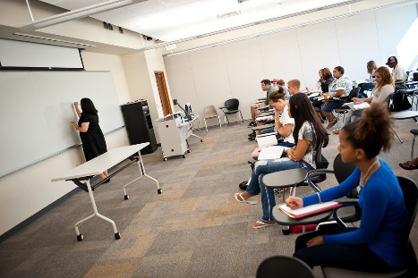
MISC.YOUTH PROGRAMS
Budget $ 6,700

Slide 10

PRO-LIFE
Pro-Life Oratory Contest held each year at the State Convention.
Winners are chosen and given awards for their excellent presentations.
Pro-Life Events throughout Louisiana
Budgeted $ 20,000.00

Slide 11
ESSAY CONTEST &
NEW PROGRAMS
Essay Contest 5 Age Groups
$50 Area winners
$200 State winners
New Programs budget $3,000
Total Budget $ 6,000

Slide 12
YOUTH EXPANSION PROGRAM
The Future is in our Hands

